Slide 1


D. M. Monadie Devmalmee Dissanayake
4/24/2025

Slide 2

Outline
Executive Summary
Introduction
Methodology
Results
Conclusion
Appendix

Slide 3
Executive Summary
Summary of methodologies
The methodologies used in this project included Data Collection, Data Wrangling, Data Analysis and Data Visualization
Summary of all results
Successful and unsuccessful Falcon 9 landing, causes of failures and the regions where the landings happened. Factors that the launch success rate depends on and determining the cost of a launch using the records of payload carried. Predicting the success of a landing.

Slide 4
Introduction
Project background and context
This capstone project aims to predict whether the Falcon 9 first stage will land successfully, which helps estimate launch costs. SpaceX's ability to reuse the first stage lowers the cost of its $62 million launches, compared to competitors' $165 million. Predicting successful landings can assist in competitive bidding against SpaceX.
Problems you want to find answers
Factors that the success rate depends on and the cost of a launch
Selecting a machine learning model to predict the success of a launch and its cost.
Accuracy of the machine learning model.

Slide 5

Section 1

Slide 6
Methodology
Executive Summary
Data collection methodology:
Falcon 9 historical launch records from a Wikipedia page titled ‘List of Falcon 9 and Falcon Heavy launches’ was obtained by web scraping.
Perform data wrangling
Exploratory Data Analysis (EDA) was perfomed to find some patterns in the data and to determine what would be label for training supervised models.
Perform exploratory data analysis (EDA) using visualization and SQL
Perform interactive visual analytics using Folium and Plotly Dash
Perform predictive analysis using classification models
Creating machine learning pipelines for predictions.

Slide 7
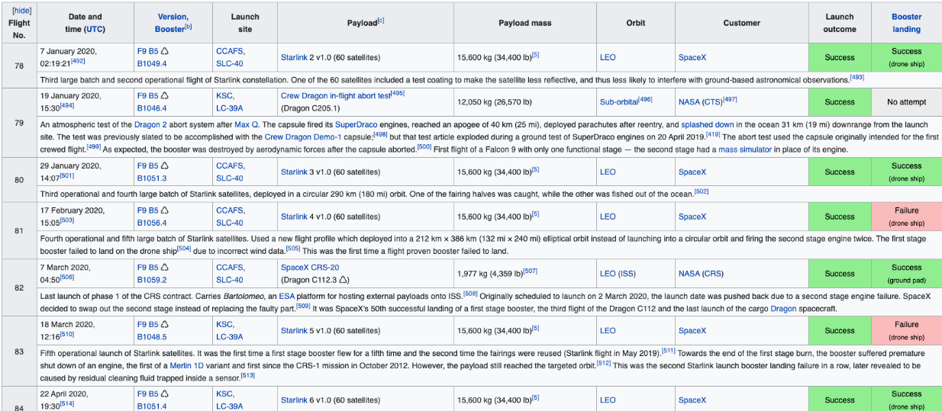
Data Collection
Data regarding the launches of the Falcon 9 was obtained from a Wikipedia page
https://en.wikipedia.org/wiki/List_of_Falcon_9_and_Falcon_Heavy_launches
The launch records are stored in a HTML table as shown below,
The data from the web page was obtained by web scraping using BeautifulSoup to parse the table and convert it into a pandas data frame

Slide 8
Data Collection – SpaceX API
https://github.com/Monadie-byte/Assignment/blob/main/jupyter-labs-spacex-data-collection-api.ipynb
Request rocket launch data from SpaceX API: response = requests.get(spacex_url)
Decode the response as a Json using .json() and turn it into a pandas dataframe: data = pd.json_normalize(response.json())
Use API to get information about launches using IDs.
Filter the dataframe
Deal with missing values using ,replace() and .mean()
Request data from SapceX API
Decode the response
Filter the data
Deal with missing values

Slide 9
Data Collection - Scraping
Request the HTML page from the URL and get a response object: response = requests.get(static_url)
Create BeautifulSoup object from the HTML response: soup = BeautifulSoup(response.text, 'html.parser')
Parse the data and record values in launch_dict, then create a data frame from it.
Export it to a CSV
https://github.com/Monadie-byte/Assignment/blob/main/jupyter-labs-webscraping.ipynb
Perform GET method to request data as a response
Create BeautifulSoup object from the response
Parse the data and record the values
Create a data frame from the records
Export as CSV

Slide 10
Data Wrangling
Load SpaceX dataset
Identify and calculate the missing values: df.isnull().sum()/len(df)*100
Identify the data types in each column: df.dtypes
Calculate the number of launches on each site. Use method value_counts() on columns to determine the number of different launches and orbits.
Create a landing outcome label from Outcome column¶: landing_class = [0 if outcome in bad_outcomes else 1 for landing_outcomes in df['Outcome’]]
Export it as a CSV: df.to_csv("dataset_part_2.csv", index=False)
https://github.com/Monadie-byte/Assignment/blob/main/labs-jupyter-spacex-Data%20wrangling.ipynb
Load data
Identify and calculate missing values
Calculate the number of launches in each site
Create a landing outcome label
Export as a CSV

Slide 11
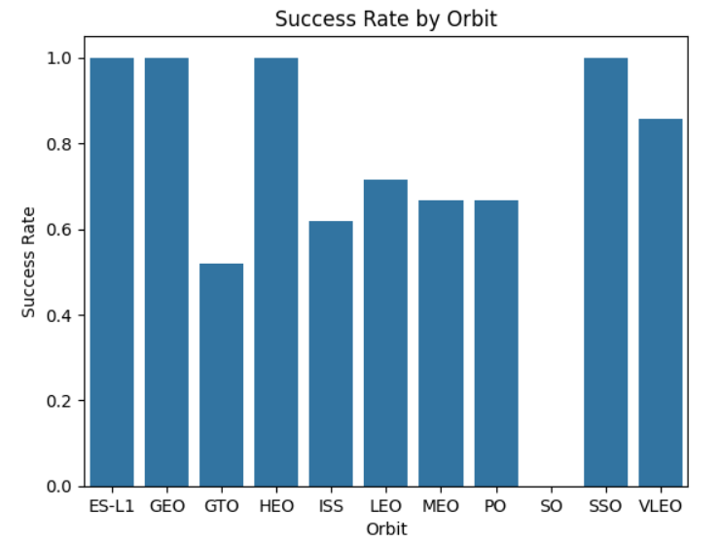
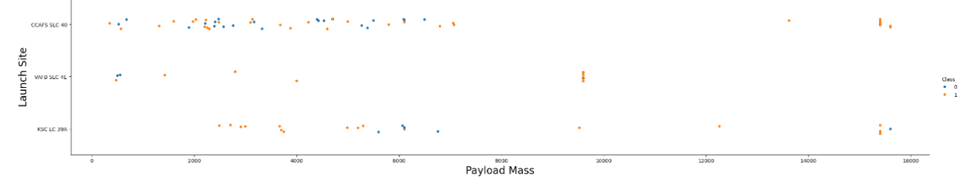
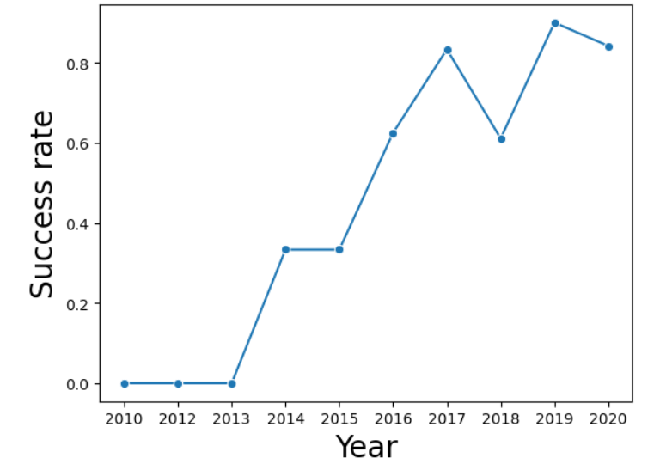
EDA with Data Visualization
Scatter plot
Flight Number vs. Payload Mass, Flight Number vs. Launch site, Payload Mass vs. Launch Site.
Bar chart
Success rate vs. Orbit type
Line chart
Launch success yearly trend
https://github.com/Monadie-byte/Assignment/blob/main/edadataviz.ipynb

Slide 12
EDA with SQL
Display the names of the unique launch sites in the space mission
Display 5 records where launch sites begin with the string ‘CCA’
Display the total payload mass carried by boosters launched by NASA (CRS)
Display average payload mass carried by booster version F9
List the date when the first succesful landing outcome in ground pad was acheived
List the names of the boosters which have success in drone ship and have payload mass greater than 4000 but less than 6000
List the total number of successful and failure mission outcomes
List all the booster_versions that have carried the maximum payload mass. Use a subquery
https://github.com/Monadie-byte/Assignment/blob/main/jupyter-labs-eda-sql-coursera_sqllite.ipynb

Slide 13
Build an Interactive Map with Folium
Markers: used to pinpoint specific locations on the map, these can be customized.
Circles: used to represent a specific radius around a point
CircleMarkers: similar to circles but the radius can be specified.
Polylines: used to draw lines connecting multiple points on a map.
GeoJSON: display complex geometries like regions or paths
Circles were added for each launch site in the dataframe.
Markers were used to generate a map with marked launch sites.
MarkerClusters are a good way to simplify many markers having the same coordinate
https://github.com/Monadie-byte/Assignment/blob/main/lab_jupyter_launch_site_location.ipynb

Slide 14
Build a Dashboard with Plotly Dash
Add a launch site drop-down input component
Add a call-back function to render success-pie-chart based on selected site dropdown
Add a range slider to select payload
Add a call-back function to render the success-payload-scatter-chart scatter plot
https://github.com/Monadie-byte/Assignment/blob/main/lab_jupyter_launch_site_location.ipynb

Slide 15
Predictive Analysis (Classification)
Load the data
Crate a NumPy array from the column Class in data by applying the method to_numpy().
Split the data into training and testing data using the function train_test_split.
Create a logistic regression object then create a GridSearchCV object.
Fit the object to find the best paramateres.
Find accuracy using method score
Find the best performing method
https://github.com/Monadie-byte/Assignment/blob/main/SpaceX_Machine%20Learning%20Prediction_Part_5.ipynb
Load data
Create a NumPy array
Split the data into training and testing sets
Create a logistic regression
Find the best parameters
Find accuracy of each method
Find the most accurate method

Slide 16
Results
Accuracy of logreg_cv was 0.8464
Accuracy of svm_cv was 0.8482
Accuracy of tree_cv was 0.8767
Accuracy of knn_cv was 0.8482
Therefore the best performing method is tree_cv
https://github.com/Monadie-byte/Assignment/blob/main/SpaceX_Machine%20Learning%20Prediction_Part_5.ipynb

Slide 17

Section 2

Slide 18
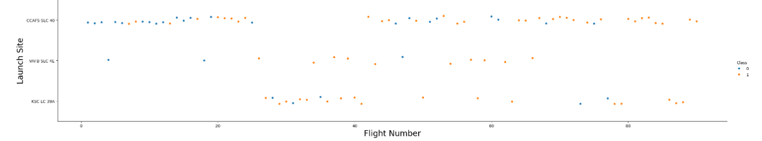
Flight Number vs. Launch Site
The graph shows the relationship between the flight number and the launch site in accordance with their class

Slide 19
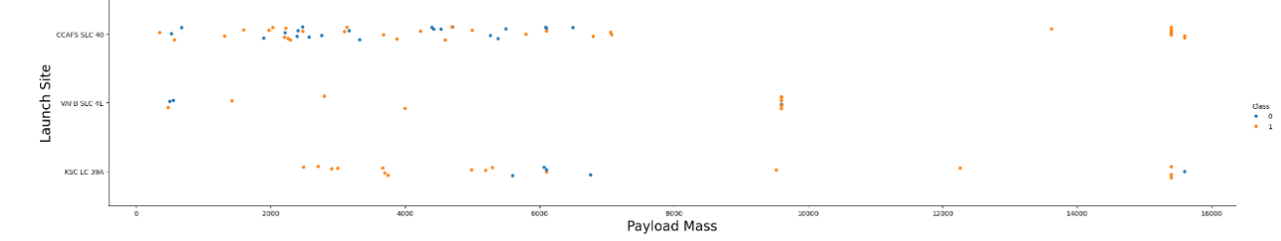
Payload vs. Launch Site
The graph shows the relationship between the payload mass and the launch site.

Slide 20
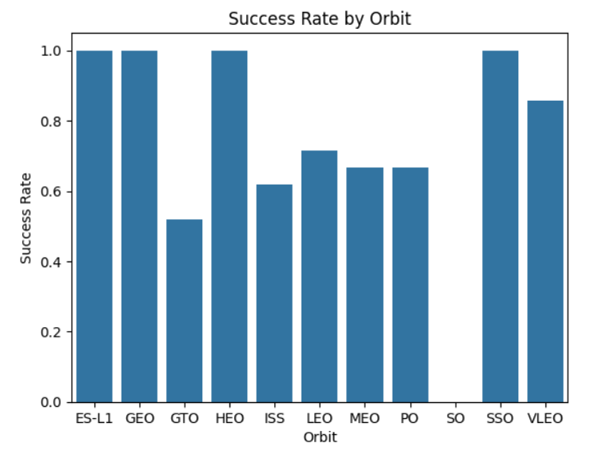
Success Rate vs. Orbit Type
The graph shows the relationship between the success rate and the orbit type.

Slide 21
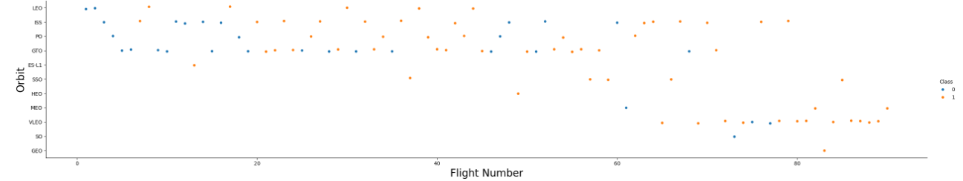
Flight Number vs. Orbit Type
The graph shows the relationship between the flight number and the orbit type.

Slide 22
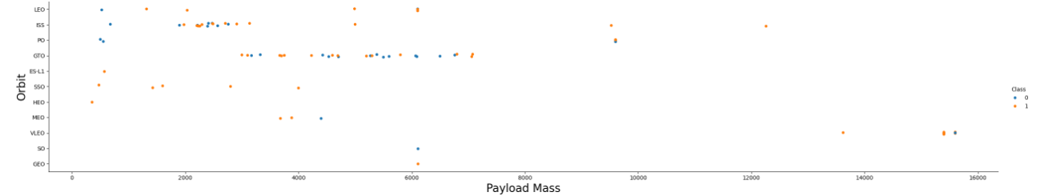
Payload vs. Orbit Type
The graph shows the relationship between the payload mass and the orbit type.

Slide 23
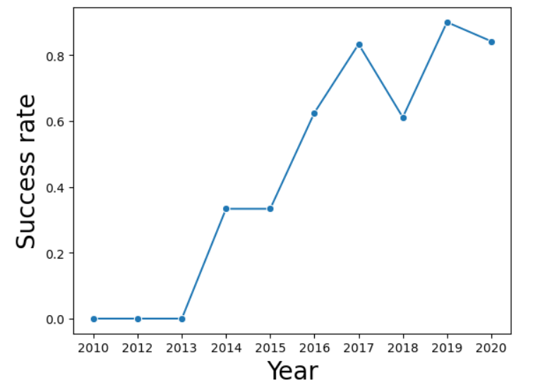
Launch Success Yearly Trend
The line chart shows the launch success yearly trend

Slide 24
All Launch Site Names
Find the names of the unique launch sites
Present your query result with a short explanation here

Slide 25
Launch Site Names Begin with 'CCA'
Find 5 records where launch sites begin with `CCA`
Present your query result with a short explanation here

Slide 26
Total Payload Mass
Calculate the total payload carried by boosters from NASA
Present your query result with a short explanation here

Slide 27
Average Payload Mass by F9 v1.1
Calculate the average payload mass carried by booster version F9 v1.1
Present your query result with a short explanation here

Slide 28
First Successful Ground Landing Date
Find the dates of the first successful landing outcome on ground pad
Present your query result with a short explanation here

Slide 29
Successful Drone Ship Landing with Payload between 4000 and 6000
List the names of boosters which have successfully landed on drone ship and had payload mass greater than 4000 but less than 6000
Present your query result with a short explanation here

Slide 30
Total Number of Successful and Failure Mission Outcomes
Calculate the total number of successful and failure mission outcomes
Present your query result with a short explanation here

Slide 31
Boosters Carried Maximum Payload
List the names of the booster which have carried the maximum payload mass
Present your query result with a short explanation here

Slide 32
2015 Launch Records
List the failed landing_outcomes in drone ship, their booster versions, and launch site names for in year 2015
Present your query result with a short explanation here

Slide 33
Rank Landing Outcomes Between 2010-06-04 and 2017-03-20
Rank the count of landing outcomes (such as Failure (drone ship) or Success (ground pad)) between the date 2010-06-04 and 2017-03-20, in descending order
Present your query result with a short explanation here

Slide 34

Section 3

Slide 35
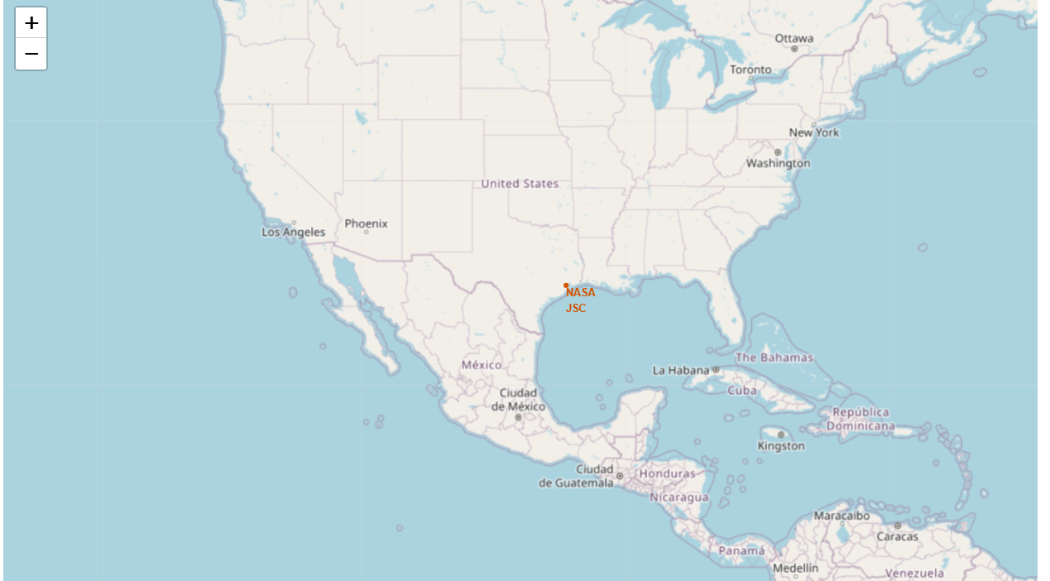
<Folium Map Screenshot 1>

Slide 36
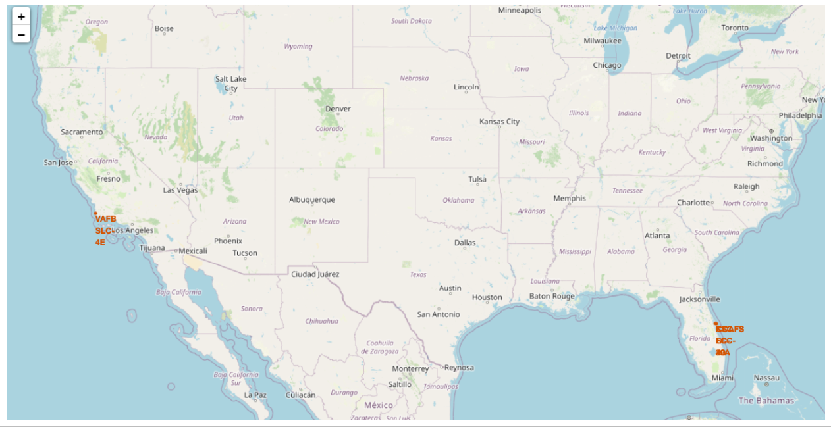
<Folium Map Screenshot 2>

Slide 37
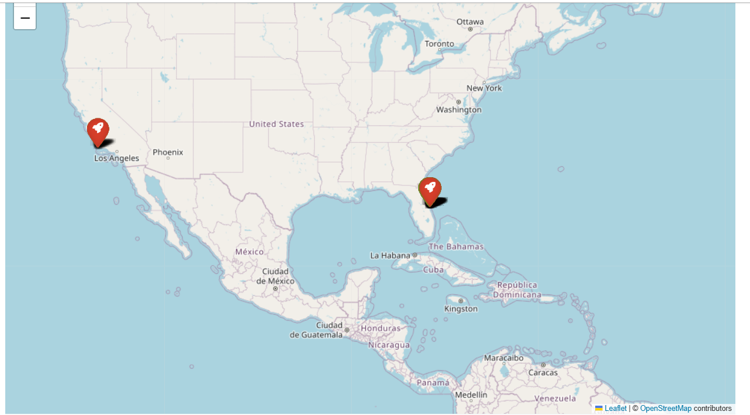
<Folium Map Screenshot 3>

Slide 38

Section 4

Slide 39
<Dashboard Screenshot 1>
Replace <Dashboard screenshot 1> title with an appropriate title
Show the screenshot of launch success count for all sites, in a piechart
Explain the important elements and findings on the screenshot

Slide 40
<Dashboard Screenshot 2>
Replace <Dashboard screenshot 2> title with an appropriate title
Show the screenshot of the piechart for the launch site with highest launch success ratio
Explain the important elements and findings on the screenshot

Slide 41
<Dashboard Screenshot 3>
Replace <Dashboard screenshot 3> title with an appropriate title
Show screenshots of Payload vs. Launch Outcome scatter plot for all sites, with different payload selected in the range slider
Explain the important elements and findings on the screenshot, such as which payload range or booster version have the largest success rate, etc.

Slide 42

Section 5

Slide 43
Classification Accuracy

Slide 44
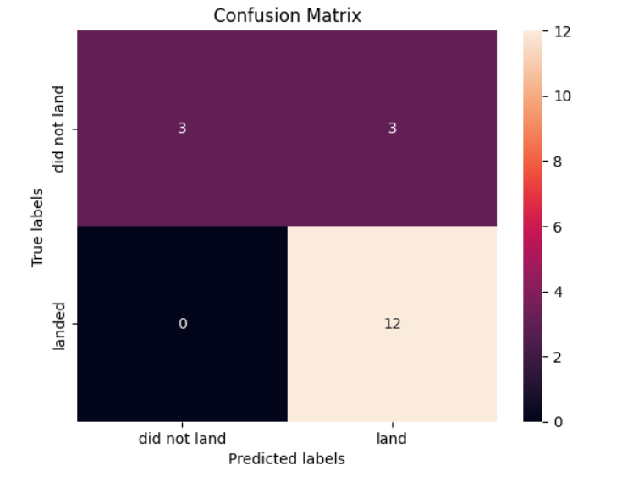
Confusion Matrix

Slide 45
Conclusions
The most accurate model is the tree_cv model
Tjis model can be used to predict the success rate and costs of launches.
However thiss model is not 100% accurate

Slide 46
Appendix
Include any relevant assets like Python code snippets, SQL queries, charts, Notebook outputs, or data sets that you may have created during this project

Slide 47


